Slide 1
Mr. Wet and his adventures!
Feat. salty and dirty

Slide 2
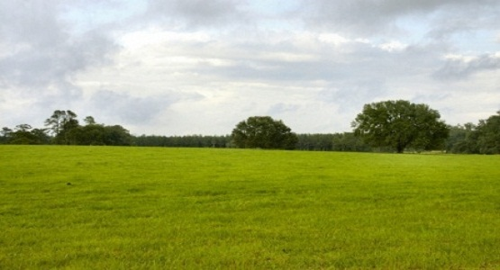
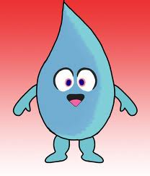
Hi, I’m Mr. Wet and I’m a rain drop!

Slide 3
I want to party!

Slide 4
So I’m going to the cloud. Watch me fly. WHEEEEEEEEEEE!

Slide 5
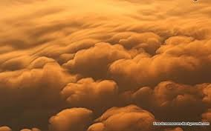
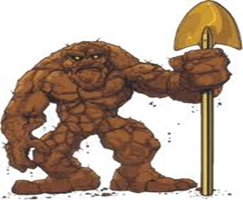
My best friends, dirty, and salty was at the cloud also.

Slide 6
While we were hanging around it had become crowded. So we left.

Slide 7
Soon we went into another cloud.

Slide 8
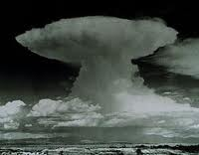
We had a cirrus great time!

Slide 9
Then we all had to leave because it was raining on our party.

